Slide 1
OFFICE OF SMALL BUSINESS PROGRAMS
Kay Doane
Small Business Program Manager
May 2023

Slide 2
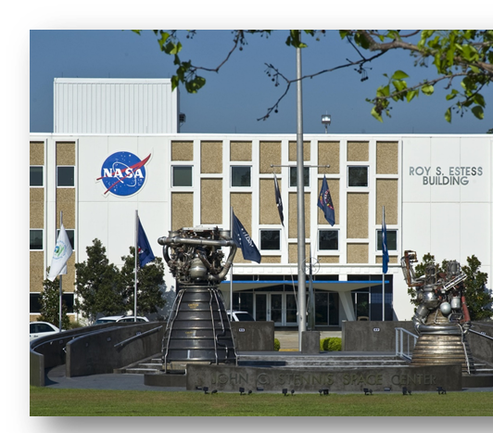
STENNIS SPACE CENTER OVERVIEW
Rocket Propulsion Testing Ground
  NASA
  Department of Defense
  Private Sector
Heavy Lift and Propulsion Technology
Commercial Crew Development
SSC Small Business Video: https://youtu.be/kOp9pi7GZic
Stennis Space Center Virtual Tour https://www.youtube.com/watch?v=tP7bNZt0QBU

Slide 3
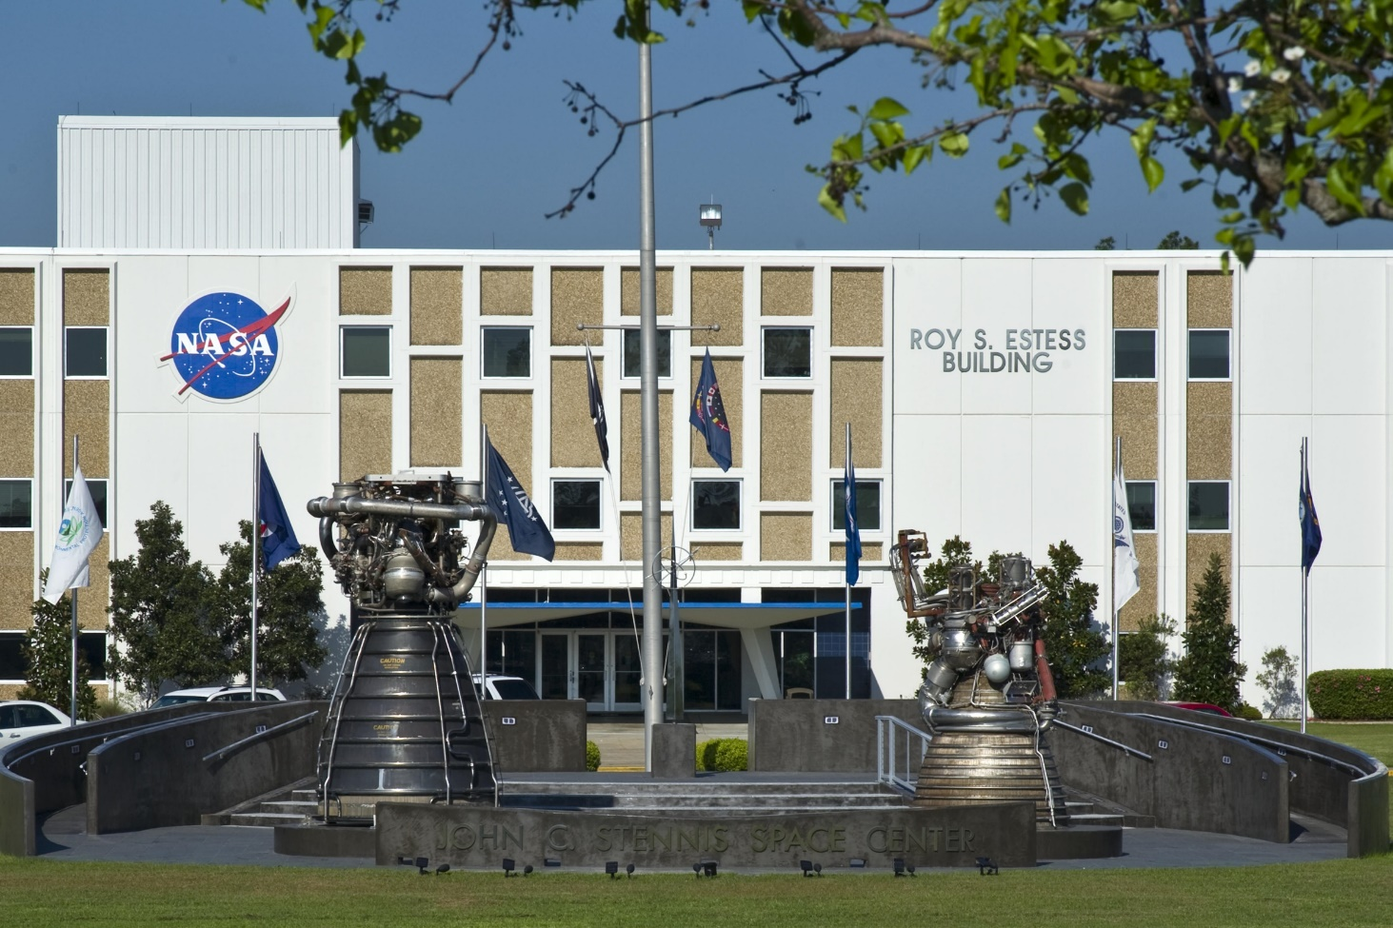
SSC Federal City
https://www.nasa.gov/centers/stennis/about/jobs/index.html
Department of Commerce (6)
National Oceanic & Atmospheric Administration (NOAA)
National Weather Service (NWS)
National Data Buoy Center
NOAA National Marine Fisheries Service
NOAA National Center for Environmental Information (NCEI)
NOAA Navigation Response Team-1
NASA Stennis Space Center (3)
NASA Rocket Propulsion Test Program
NASA Shared Services Center (NSSC)
National Center for Critical Information Processing & Storage (NCCIPS)
Government Publishing Office
Passport Production Facility
Department of Defense (10)
Army Corps of Engineers
Commander, Naval Meteorology & Oceanography Command (CNMOC)
Navy Detachment Stennis
Navy Facilities Southeast
Naval Oceanographic Office (NAVO)
Navy Office of Civilian Human Resources
Naval Research Laboratory (NRL)
Navy Small Craft Instruction and Technical Training School (NAVSCIATTS)
Navy Special Boat Team 22 (SBT-22)
Naval Special Warfare Center (NSWC)
Government Services Agency
Information Systems at NCCIPS
Commercial Companies (4)
Aerojet Rocketdyne
Lockheed Martin
Relativity Space Incorporated
Rolls Royce North America
Contractors (15)
A2 Research
Bastion
Booz Allen Hamilton
General Dynamics Information Technology (GDIT)
Deltha Corporation
Leidos
NAVAR
Northrop Grumman
Pacific Architects and Engineers (PAE)
Pinnacle Solutions
Chenega Global Protection
SAITECH
Science Applications International Corporation (SAIC)
Science Systems and Applications Inc.
Syncom Space Services (S3)
Department of Energy
Strategic Petroleum Reserve
Department of Homeland Security (3)
DHS Data Center 1
Immigration & Customs Enforcement (ICE)
United States Citizenship & Immigration
Services (USCIS)
Department of Interior
U.S. Geological Survey (USGS),
Hydrologic Instrumentation Facility
Department of Transportation
Information Systems at NCCIPS
University of Southern Mississippi
Dept. of Marine Science
Center for Higher Learning
Mississippi State University
Pearl River Community College
University of Mississippi
University of New Orleans
University of Southern Mississippi
Mississippi State University (2)
Northern Gulf Institute
ASSURE FAA UAS Center of Excellence
State of Mississippi (2)
Mississippi Enterprise for Technology (MSET)
Marine Industries Science & Technology (MIST) Cluster
State of Louisiana (2)
Louisiana Technology Transfer Office
Louisiana Business & Technology Center - LSU
3

Slide 4

FY 2022 Small Business Metrics
Total Dollars* $19.7 Billion
…of that:
Total Dollars to Small Business $ 7.1 Billion
…of that:
Prime Small Business $ 3.63 Billion
Subcontract Small Business $ 3.47 Billion

Slide 5
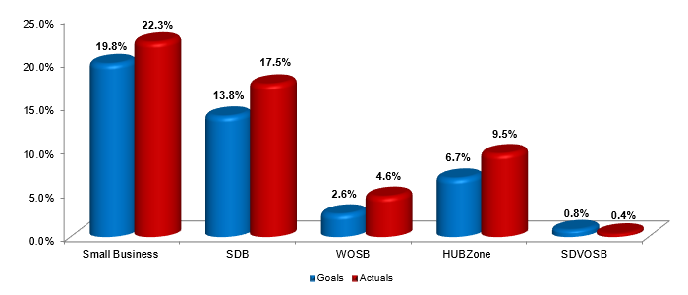
FY23
Prime Goals vs. actual percentages
FY22 SSC exceeded all 5 of its socio-economic Small Business goals with over $143M Awarded
Earned the NASA Golden Eagle Award for exceeding the federally mandated 3% Service Disabled Veteran Owned Small Business (SDVOSB) goal with 3.8%.
16 years SSC exceeded the Federal Small Disadvantage Business 5% goal with 24%
10 years SSC exceeded the Federal Small Business 23% goal with 36.4.3%
10 years SSC exceeded the Federal HUBZone 3% goal with 10.1%

Slide 6
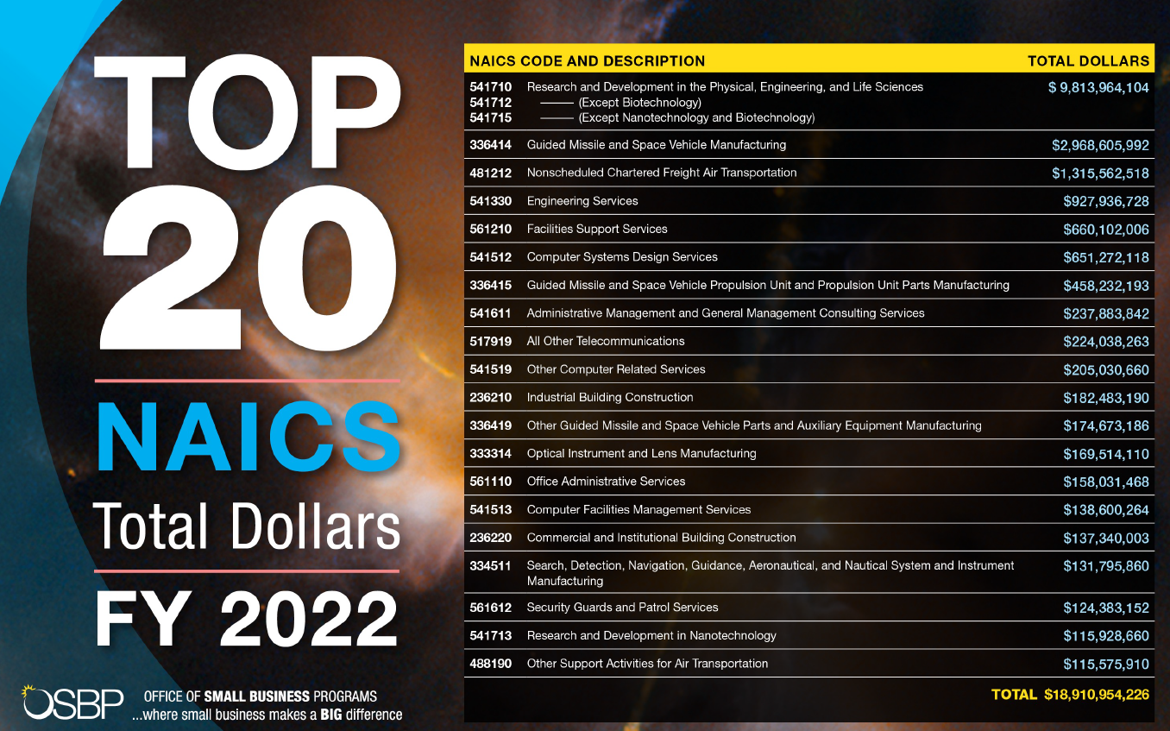

Slide 7
SSC Top NAICS

Slide 8
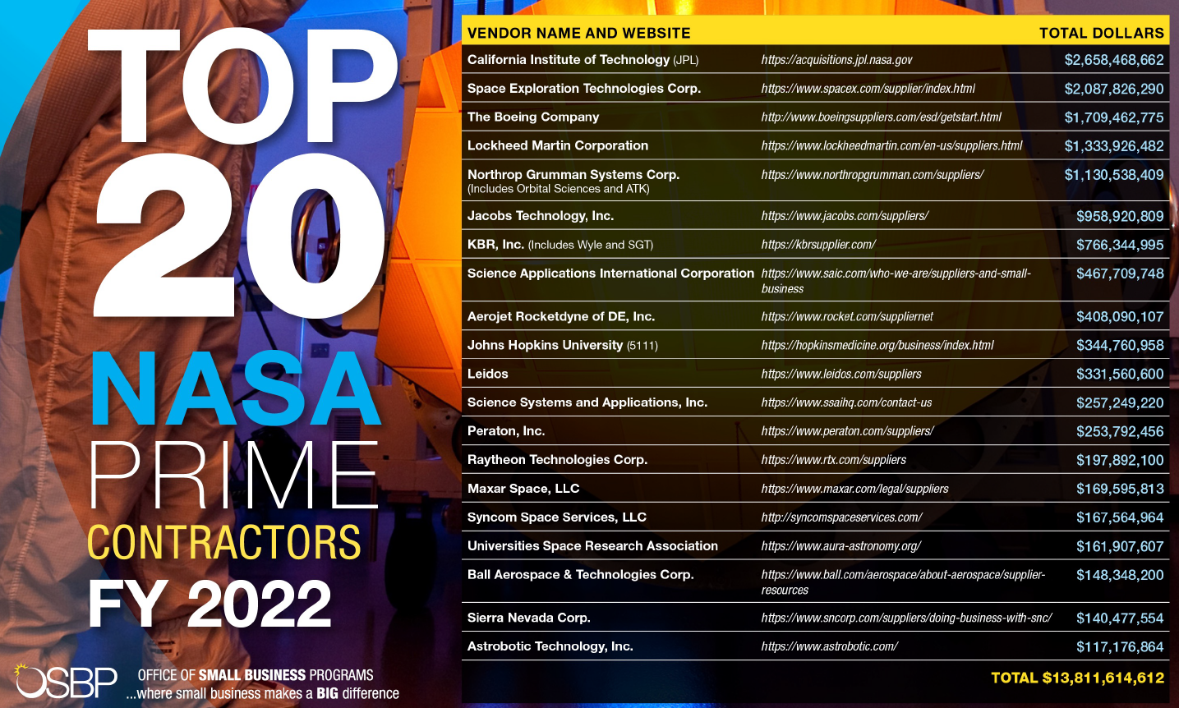

Slide 9
SSC Prime Vendors

Slide 10
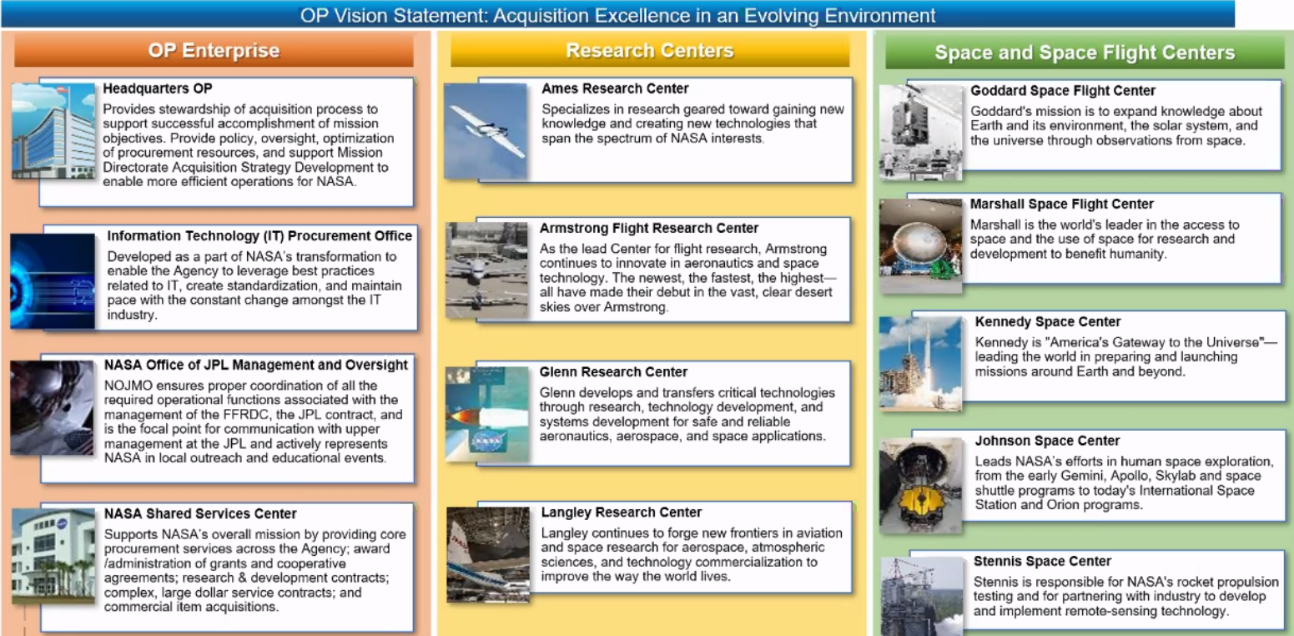
Enables the Agency’s mission and execute contracts in support of programmatic, institutional, and operational needs

Slide 11
PSL Service Delivery Model
GSFC
★ Financial Support Services
★ PP&C
★ Protective Services
★ Admin. Services
ITPO
▲ IT Services
GRC
★ A&E Services
★ Construction
▲ Custodial Services
▲Centralized: Procures for Agency
★ Regionalized
● Remains Localized at each Center
  Environmental Compliance
  Utilities
  Facilities O&M
  Engineering
    Safety & Mission Assurance
    Tech Transfer*
Regionalized or centralized buying locations does not equate to consolidation of contracts It is the Procurement Office that has overall responsibility of Contract Award (e.g., SEB).
AFRC
★ A&E Services
★ Construction
★ Aircraft O&M
★ Admin. Services
LaRC
★ Admin. Services
▲ Grounds Maintenance
ARC
★ Protective
Services
MSFC
★ Financial Support Services
▲ Logistics
★ PP&C
▲ ● Tech Transfer (MSFC, SSC, HQ)
NSSC
▲ Acquisition Support Services
▲ Human Capital
▲ ODEO / EEO
▲ OSTEM
SSC
★ Construction
★ Admin. Services
KSC
★ A&E Services
▲ Communication Services
▲ Environmental Remediation
▲ Propellants
★ Protective Services
▲ Fire Services
JSC
▲ Occupational
Health
★ Aircraft O&M
*Consolidated Agency Technology Transfer Services (CATTS) contract will replace the current Technology Transfer Services Agency Contract expiring July 2023. Participating centers include HQ, MSFC, SSC with other Centers having the option to join at a later date.

Slide 12
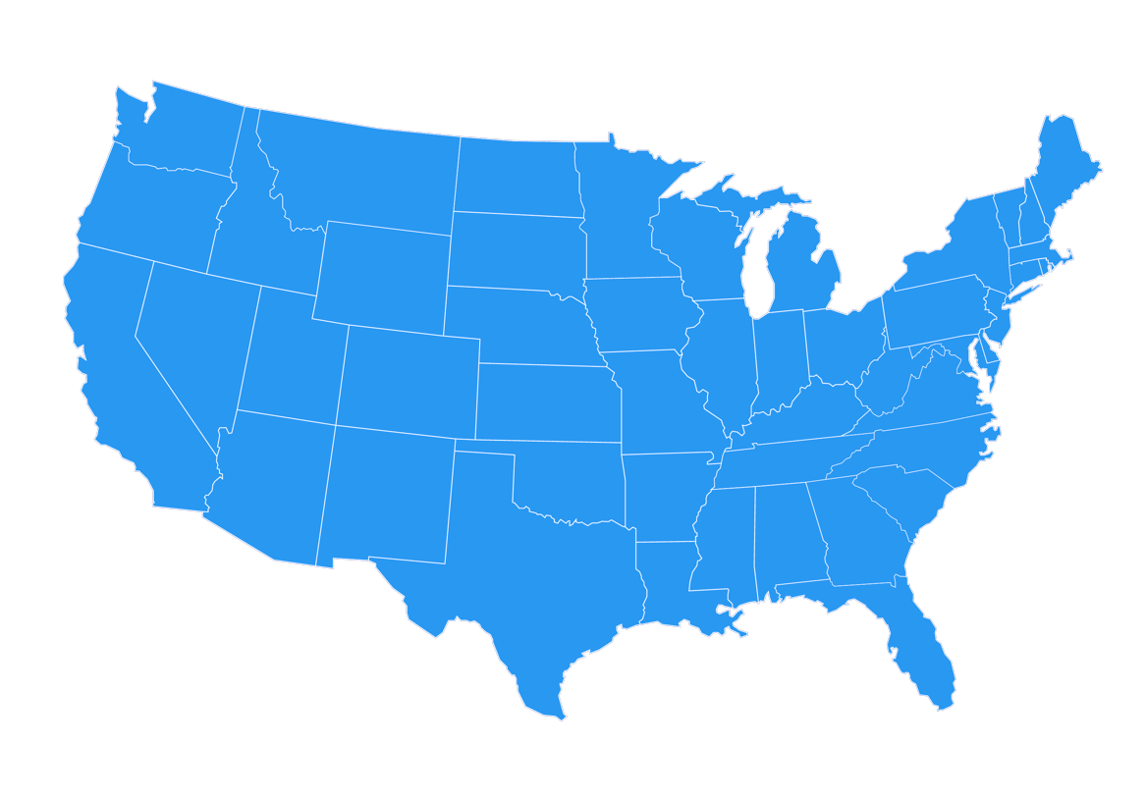











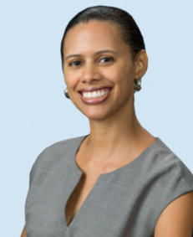



NASA Small Business Specialists Around the Country
Ames Research Center
Aerospace and Small Spacecraft
Moffett Field, CA
Armstrong Flight Research Center
Atmospheric Research and Testing
Edwards, CA
Christine L. Munroe
Glenn Research Center
Aeronautics and
Spacecraft Technology
Cleveland, OH
Eunice J. Adams-Sipp
Goddard Space Flight Center
Science Missions and Telescopes
Greenbelt, MD
Jennifer D. Perez
Sholainka O. Martyn
Kandace P. Chappell
Djaataa Onanuga
IT Procurement Office
(Virtual)
Langley Research Center
Aviation and Space Research
Hampton, VA
Robert O. Betts
Johnson Space Center
Human Space Flight Operations
Houston, TX
NASA Shared Services Center
Agency Contract Support
Bay St. Louis, MS
Troy E. Miller
Kennedy Space Center
Space Vehicle Launch and Landing
Cape Canaveral, FL
Joyce C. McDowell
Natalie B. Colvin
.
Robert E. Watts
Monica F. Craft
Tumarrow Romain
Stennis Space Center
Vehicle Engine Testing
Bay St. Louis, MS
Kay S. Doane
Marshall Space Flight Center
Space Transportation, Propulsion Systems, Space Systems, and Science
Huntsville, AL
David E. Brock

Slide 13
NASA Small Business Specialists
Center Category | Center | Name | Phone | Email
Research Centers | Ames Research Center | Christine L. Munroe | 650-604-4695 | Arc-smallbusiness@mail.nasa.gov
 | Armstrong Flight Research Center | Christine L. Munroe | 650-604-4695 | Arc-smallbusiness@mail.nasa.gov
 | Glenn Research Center | Eunice J. Adams-Sipp | 216-433-6644 | Grc-smallbusiness@mail.nasa.gov
 | Langley Research Center | Robert O. Betts | 757-864-6074 | Larc-smallbusiness@mail.nasa.gov
Space Centers | Johnson Space Center | Robert E. Watts | 281-244-5811 | Jsc-smallbusiness@mail.nasa.gov
 | Kennedy Space Center | Joyce C. McDowell | 321-867-3437 | Ksc-smallbusiness@mail.nasa.gov
 | Marshall Space Flight Center | David E. Brock | 256-544-0267 | Msfc-smallbusiness@mail.nasa.gov
 | Stennis Space Center | Kay S. Doane | 228-688-1720 | Ssc-smallbusiness@mail.nasa.gov
Science Center | Goddard Space Flight Center | Jennifer D. Perez | 301-286-4379 | Gsfc-smallbusiness@mail.nasa.gov
Agency-Wide Resource Center | Information Technology Procurement Office | Robert O. Betts | 757-864-6074 | hq-itpo-smallbusiness@mail.nasa.gov
 | NASA Shared Services Center | Troy E. Miller | 228-813-6558 | nssc-smallbusiness@mail.nasa.gov

Slide 14
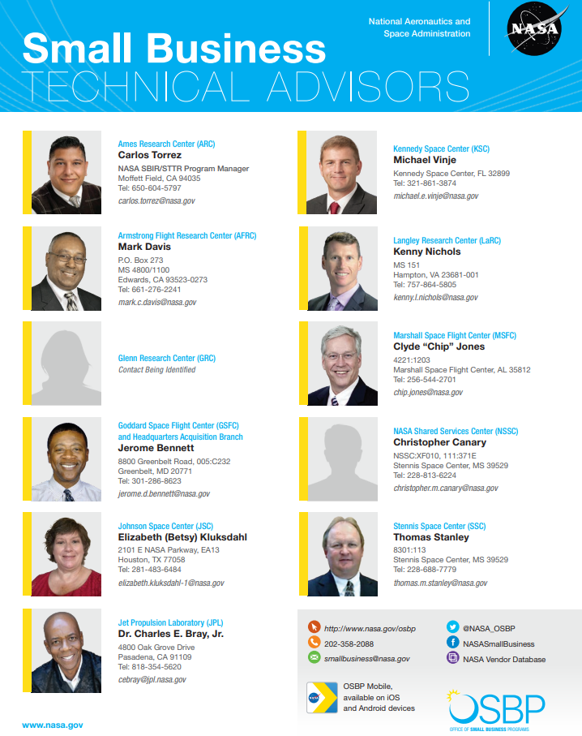

Slide 15
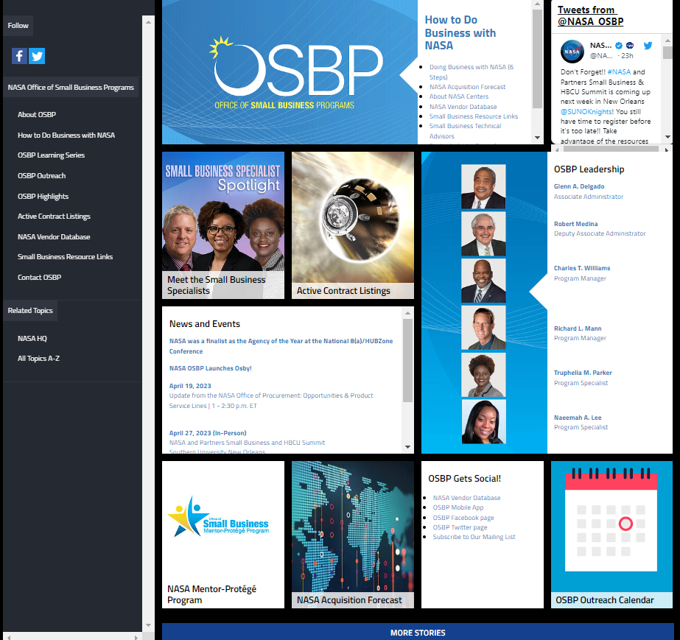
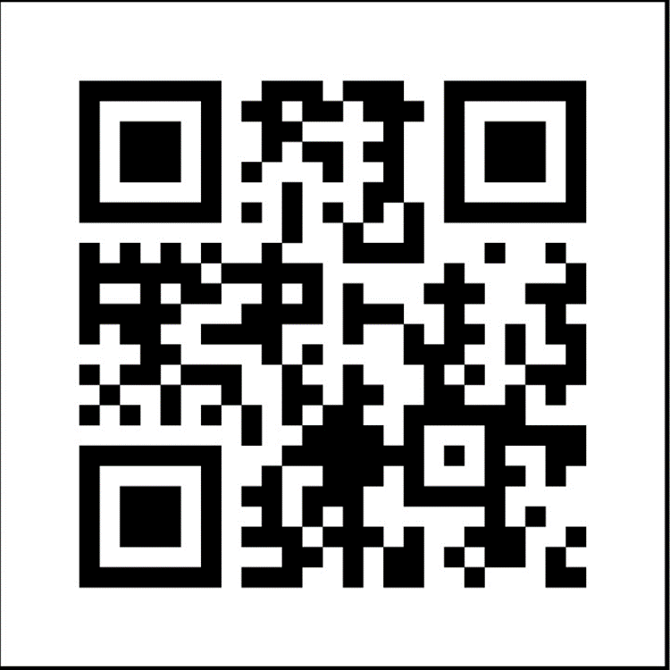
nasa.gov/osbp
NASA Office of Small Business Programs QR Code

Slide 16

NASA Vendor Database
https://www.nasa.gov/osbp/nasa-vendor-database
The NASA Vendor Database (NVDB) is open to all vendors, both large and small, who wish to do business with the National Aeronautics and Space Administration.
  Build a company profile
  Conduct vendor search
  Increase company visibility at NASA!

Slide 17

Active contract listings
Recurring contracts
Long-term planning purposes
https://www.nasa.gov/osbp/active-contract-listings
  Accounting/Financial/Business Services
  Administrative Services
  Environmental Services and Remediation
  Facilities Maintenance
  IT
  Multiple Award Construction
  Occupational Health
  Protective Services

Slide 18
ACTIVE CONTRACT LISTINGS
NASA FACILITIES CONTRACTS
CENTER | NAICS | CONTRACT NAME | CONTRACTOR NAME CONTRACT # | TYPE OF COMPETITION | POTENTIAL VALUE | ULTIMATE CONTRACT END DATE
ARC | 561210 | Safety & Mission Assurance | Bastion Technologies, Inc. 80ARC020D0012 | Full & Open | $66.6 M | 10/31/2024 Last Date to Order
ARC | 561210 | Aerospace Testing & Facilities O&M (ATOM-5) | Jacobs Technology 80ARC022DA011 | Full & Open | $298 M | 6/21/2027 Last Date to Order
ARC | 561210 | Logistics Management Services (LMS) | Lockwood Hills, LLC 80ARC017C0001 | SB Set-Aside | $54.6 M | 5/14/2024
ARC | 561210 | Ames Facilities Maintenance Support Services (AFSS) | Jacobs Technology NNA15BB23C | Full & Open | $232 M | 10/12/2025
GRC | 561720 | Janitorial Services | Creative Management Technology 80GRC020C0007 | SB Set-Aside | $15.4 M | 7/31/2025
GRC | 561210 | Technical, Facilities, O&M, & Engineering (TFOME) | HX5 Sierra, LLC NNC15BA02B | SB Set-Aside | $379.9 M | 5/31/2025
GSFC | 561210 | O&M for IV&V Facility | West Virigina University Research Corporation 80GSFC19C0074 | Sole Source | $25 M | 9/30/2025
GSFC | 561210 | Facilities Operations and Maintenance Services (FOMS) III | AKIMA Support Operation, LLC 80GSFC18C0054 | 8(a) Competitive | $142.3 M | 5/14/2023
GSFC | 561720 | Custodial, Landscaping, and Recycling Services | Melwood Horticultural Training Center, Inc. 80GSFC20C0098 | Ability One | $27.8 M | 6/30/2025
GSFC | 561210 | Northern Latitude Sounding Rocket Launch Site | University of Alaska-Fairbanks 80GSFC20C0023 | Sole Source | $30 M | 11/30/2029
GSFC/WFF | 561730 | Landscaping & Trash and Recycling Removal at WFF | Didlake, Inc. 80GSFC20D0010 | Ability One | $4.1 M | 4/19/2025 Last Date to Order

Slide 19

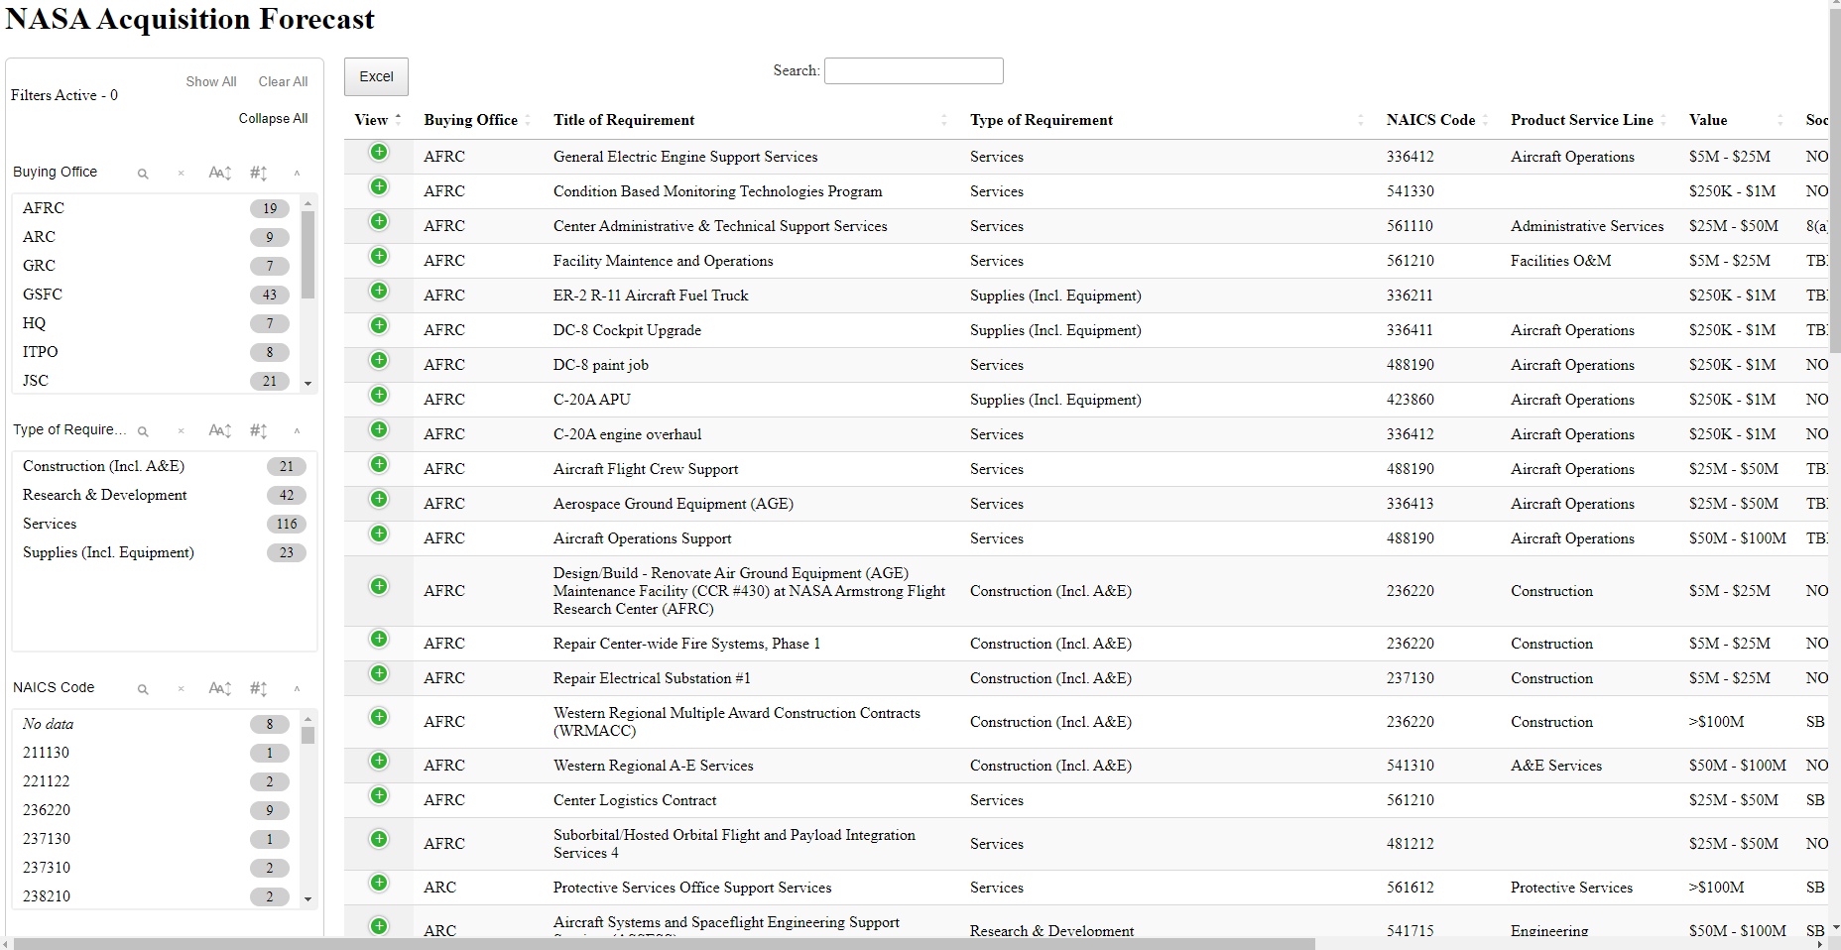
NASA Acquisition Forecast
http://www.hq.nasa.gov/office/procurement/forecast/

Slide 20
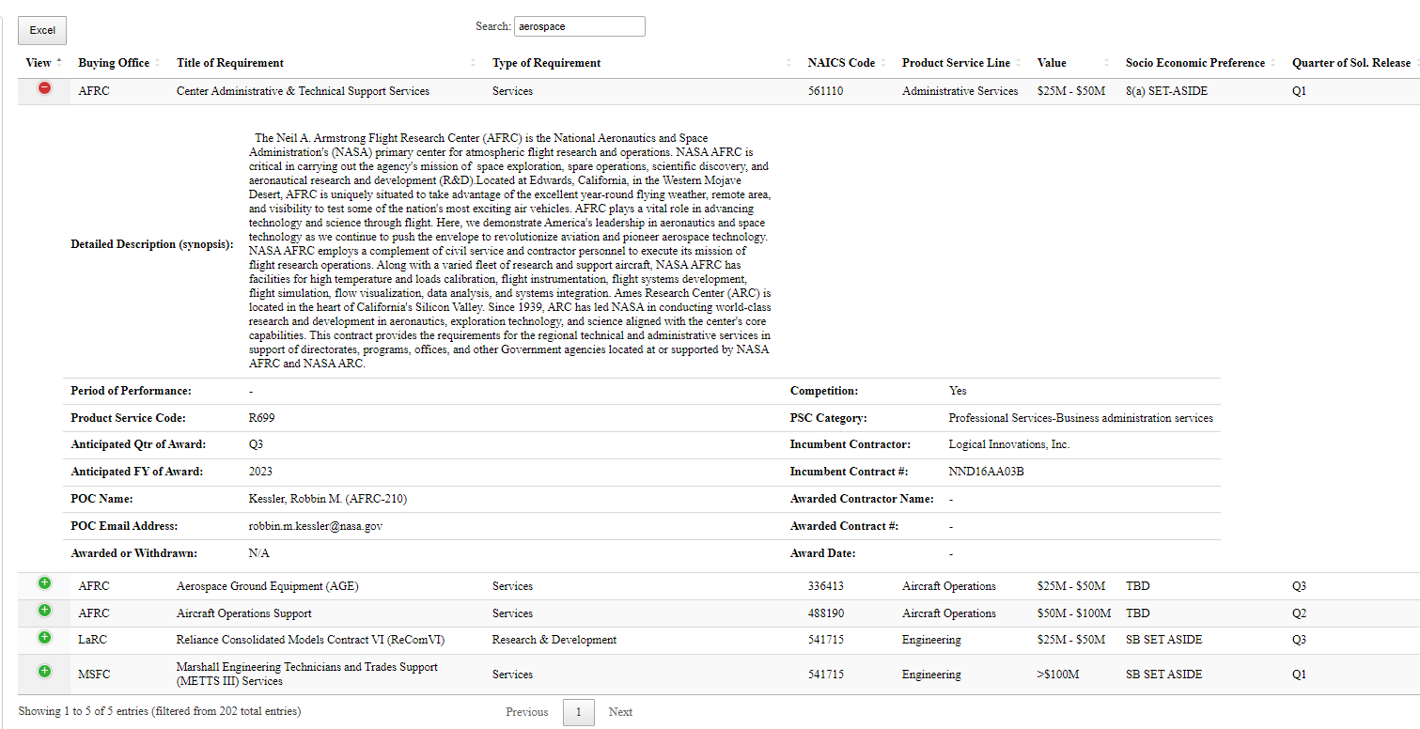

Slide 21

NASA Mentor-Protégé Program
The NASA MPP encourages NASA prime contractors to assist eligible Protégés, thereby enhancing the Protégés’ capabilities to perform on NASA contracts and subcontracts, fostering the establishment of long-term business relationships between these entities and NASA prime contractors, and increasing the overall number of these entities that receive NASA contract and subcontract awards.
Webpage: https://www.nasa.gov/osbp/mentor-protege-program
E-mail Address MSFC-NASAMentorProtegeProgram@mail.nasa.gov
Approved Mentors (as of Jan 2023)
a.i. Solutions, Inc.
AECOM
Amentum Services, Inc. (New Mentor)
Bastion Technologies, Inc. (New Mentor)
Bechtel National, Inc. (New Mentor)
Blue Origin (New Mentor)
CACI, Inc. – Federal (New Mentor)
CH2M Hill, Inc. (New Mentor)
Deloitte & Touche, LLP (New Mentor)
Enterprise Services, LLC
General Dynamics Information Technology, Inc. [GDIT] (New Mentor)
Honeywell International, Inc. (Aerospace-Glendale)
Jacobs Technology, Inc
Jones Edmunds & Associates, Inc. (New Mentor)
Leidos Innovations Corporation
LJT & Associates, Inc.
Lockheed Martin
Northrop Grumman
PAE Applied Technologies, LLC
Peraton, Inc. (New Mentor)
Raytheon Company
REI Systems, Inc. (New Mentor)
Science Applications International Corporation (SAIC)
Sierra Lobo, Inc.
Southwest Research Institute
Teledyne Brown Engineering, Inc.
The Boeing Company
Wyle Laboratories, Inc. d/b/a KBRWyle

Slide 22
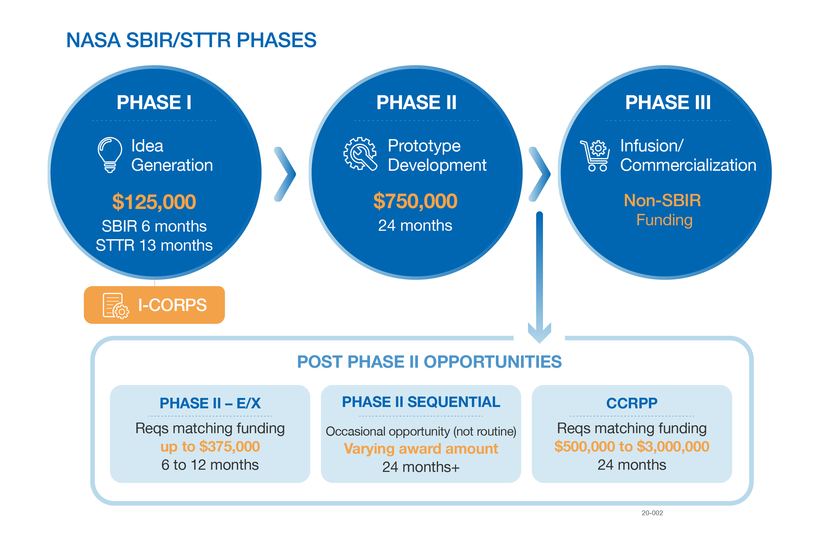
NASA SBIR/STTR
https://sbir.nasa.gov/
Small Business Innovation Research (SBIR)
  A set-aside program for small business concerns to engage in Federal R&D with potential for commercialization
  Currently, 3.2% of Federal agencies’ extramural R&D budgets >$100M per year
Small Business Technology Transfer (STTR)
  A sister set-aside program to facilitate cooperative R&D between small business concerns and U.S. research institutions with potential for commercialization
  Currently, 0.45% of the extramural research budget for all agencies with a budget >$1B per year
Notes:
…a look at exactly what our program offers to small businesses like yours—or what we call the “phases” of the NASA SBIR/STTR program.
We find and fund our small businesses through “Phases”, as shown on the screen right now. I won’t go over every detail of each one, but at a high level:
Phase I is what we like to call the “idea phase”;
Phase II is focused on the actual development, demonstration, and delivery of the innovation; and
Phase III is where the small businesses’ innovative technologies, products, or services make their way into NASA missions and/or the commercial marketplace;
But, to put it plainly, getting to a successful Phase III is tough. Phase I and II awards alone are not typically enough to support a company’s journey to commercialization. So, our Program has created additional opportunities to help firms get there—and with more than just funding—through initiatives like the I-Corps program and our various post-Phase II vehicles.
I-Corps provides business assistance and training to our firms that, in turn, help them develop better products and grow.
Additionally, our post-Phase II vehicles are important mechanisms for our program to be able to support small businesses as they transition their technologies—readying them for either commercialization into the marketplace or infusion into a NASA mission. For example, last summer, you may have seen that NASA announced $29 million in awards through our Phase II Sequential awards. This money was given to just seven of our Program’s small businesses in order accelerate the development of lunar technologies relevant to Artemis. We have another Sequentials opportunity running this year, and expect to announce those awards over the summer, so stay tuned for that!

Slide 23
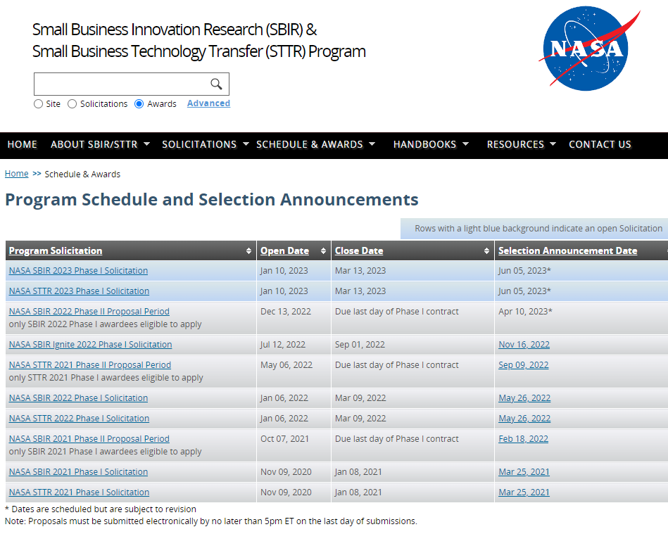

Slide 24
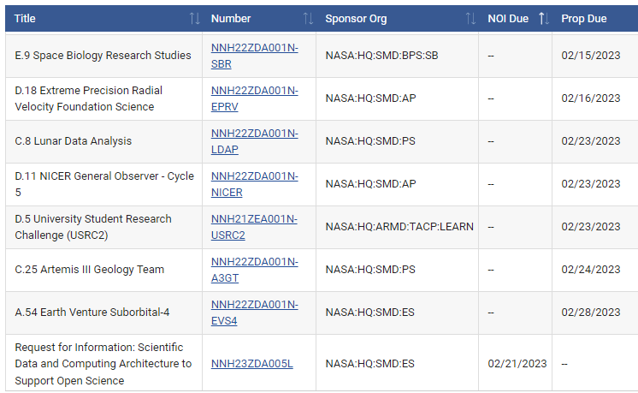
NASA Solicitation and Proposal Integrated Review and Evaluation System
(NSPIRES)
https://nspires.nasaprs.com/external/
Research in science and technology is an important part of NASA's overall mission.
NASA solicits this research through the release of various research announcements in a wide range of science and technology disciplines.
NASA uses a peer review process to evaluate and select research proposals submitted in response to these research announcements.
Researchers can help NASA achieve national research objectives by submitting research proposals and conducting awarded research.
Solicitations
NSPIRES now allow users to SEARCH for and view Proposals and NOIs due in 30 days, FUTURE, and OPEN, CLOSED/PAST NASA research announcements. The full text of the Solicitation Announcements and information about selected proposals, if available, can be viewed and downloaded.
Notes:
…a look at exactly what our program offers to small businesses like yours—or what we call the “phases” of the NASA SBIR/STTR program.
We find and fund our small businesses through “Phases”, as shown on the screen right now. I won’t go over every detail of each one, but at a high level:
Phase I is what we like to call the “idea phase”;
Phase II is focused on the actual development, demonstration, and delivery of the innovation; and
Phase III is where the small businesses’ innovative technologies, products, or services make their way into NASA missions and/or the commercial marketplace;
But, to put it plainly, getting to a successful Phase III is tough. Phase I and II awards alone are not typically enough to support a company’s journey to commercialization. So, our Program has created additional opportunities to help firms get there—and with more than just funding—through initiatives like the I-Corps program and our various post-Phase II vehicles.
I-Corps provides business assistance and training to our firms that, in turn, help them develop better products and grow.
Additionally, our post-Phase II vehicles are important mechanisms for our program to be able to support small businesses as they transition their technologies—readying them for either commercialization into the marketplace or infusion into a NASA mission. For example, last summer, you may have seen that NASA announced $29 million in awards through our Phase II Sequential awards. This money was given to just seven of our Program’s small businesses in order accelerate the development of lunar technologies relevant to Artemis. We have another Sequentials opportunity running this year, and expect to announce those awards over the summer, so stay tuned for that!

Slide 25


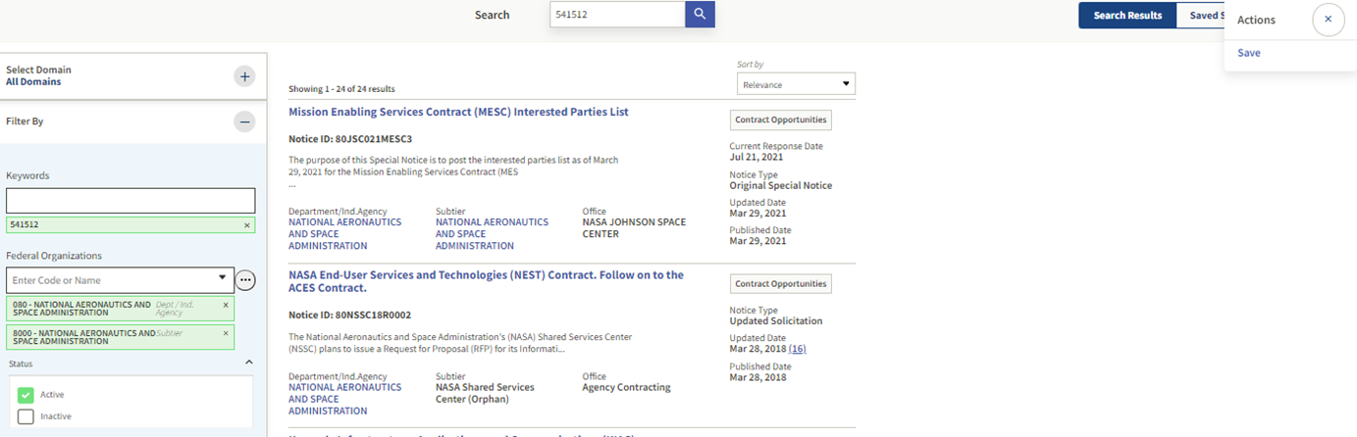

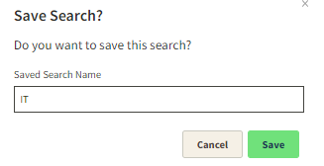

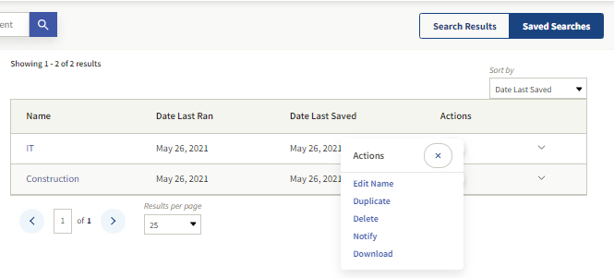
Save Searches and Set Up Notifications for Contract Opportunities in SAM.gov.

Slide 26
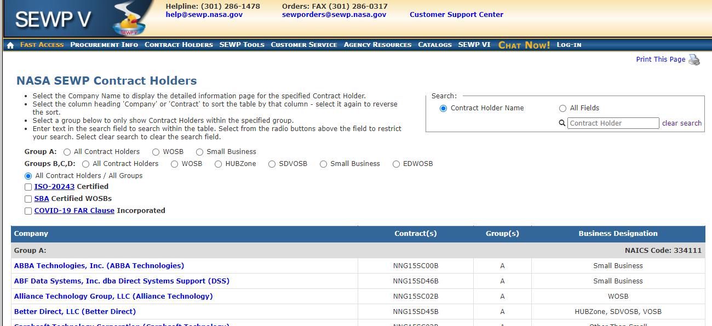
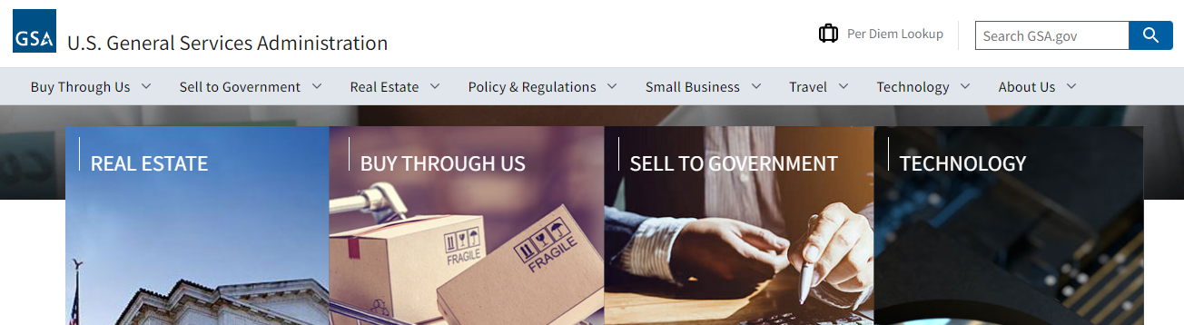
SEWP – IT VARs
https://sewp.nasa.gov/
/

Slide 27
Getting a Contract Takes Time
Research opportunities
Build relationships
  Research Center Industry Councils
  Mentor-Protégé Program
Be persistent but not a stalker
Prepare for upcoming opportunities 18 to 24 months in advance of solicitation
Respond to and review NASA Sources Sought and Request for Information solicitations
Phone call vs. Email

Slide 28


Online: https://www.nasa.gov/osbp/regional-outreach
Online: https://www.nasa.gov/osbp/learning-series
Upcoming Outreach Events & Webinars
July 20, 2023
NASA Small Business Conference and Networking (Virtual)
October 12, 2023 (tentatively)
Washington, DC area
In-person

Slide 29
OSBP – Learning Series
1:00 p.m. - 2:30 p.m. ET For Registration https://www.nasa.gov/osbp/learning-series
May 17, 2023, How to Do Business with NASA featuring Agency Science and Resource Centers
(NASA IT Procurement Office, Goddard Space Flight Center, NASA Shared Services Center)
June 21, 2023, Annual Small Business Town Hall
July 19, 2023, NASA SEWP Update
August 16, 2023, How to Build a Relationship with Agency Primes: A One-on-one Conversation with Small Business Liaison Officers
September 20, 2023, How to Write Winning Proposals and Impactful Capability Statements
Archive https://www.nasa.gov/osbp/learning-series-archive
August 17, 2022, NASA Mentor-Protégé Program Update https://youtu.be/ot9lINMbzrE
September 21, 2022, HUBZone Program Update and Resources for Small Business https://youtu.be/d3KjeU8SzuM
October 19, 2022, How to do Business with the NASA Information Technology (IT) Procurement Office https://youtu.be/WFEYgsIIzp0
November 16, 2022, How to Do Business with NASA featuring Agency Space Centers https://youtu.be/VzGcHQcOtyw
December 14, 2022, NASA Mission Equity: Tribal Consultation Plan Update https://youtu.be/vh8lh-Dzdhs
January 18, 2023, NASA SBIR/STTR Program Update https://youtu.be/siLhPITClQk
February 15, 2023, Resources and Best Practices from NASA Federal Partners and Trade Associations https://youtu.be/ezRezDJoSGw
March 15, 2023, How to Do Business with NASA Featuring Agency Research Centers
(Ames Research Center, Armstrong Flight Research Center, Glenn Research Center, Langley Research Center)
https://youtu.be/AWLpCEoXmV0
April 19, 2023, Update from the NASA Office of Procurement: Opportunities & Product Service Lines

Slide 30
Helpful references
NASA Office of Small Business Programs | www.nasa.gov/osbp
OSBP – Active Contract Listings | www.nasa.gov/osbp/active-contract-listings
NASA Field Centers Webpage | www.nasa.gov/osbp/about-nasa-centers
NASA Consolidated Acquisition Forecast | www.hq.nasa.gov/office/procurement/forecast/
NASA Vendor Database | NASA Vendor Database | NASA
NASA FOIA Reading Rooms | http://www.nasa.gov/FOIA/NASA-Centers.html
Solutions for Enterprise-Wide Procurement (SEWP) | https://sewp.nasa.gov/
SBA Dynamic Small Business Search | https://dsbs.sba.gov/search/dsp_dsbs.cfm
APEX Accelerators The Procurement Technical Assistance Program (PTAP) or PTAC is now under the management of the Department of Defense (DOD) Office of Small Business Programs (OSBP) and has changed its name to APEX Accelerators. | Apex Accelerators
SAM.gov | www.sam.gov/content/home

Slide 31
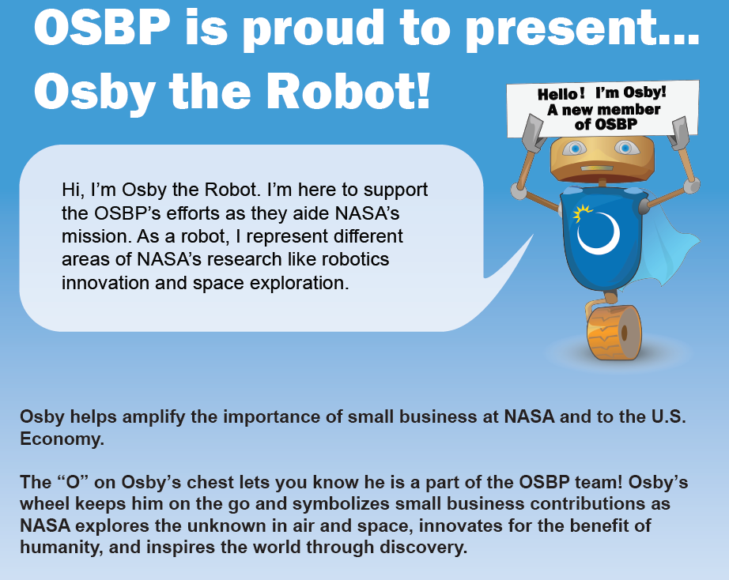

Slide 32
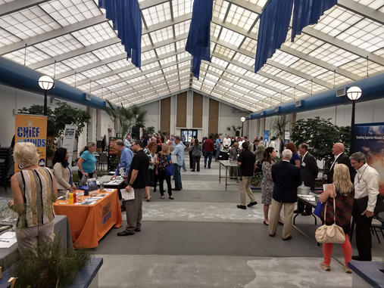
Outreach Opportunities
Small Business Virtual Showcase (Feb/May/Aug/Nov)
Email: ssc-smallbusiness@mail.nasa.gov
  The Virtual Showcase will allow you to provide a 10min capabilities presentation. Possible attendees include, as available, NASA Small Business Specialists, Technical Advisors, Contracting Officers, Prime Contractor representatives and local tenants of SSC.
Stennis Business Consortium through Mississippi Enterprise For Technology (MSET)
  SSC Resident Agencies and Prime Contractors
  Quarterly Meetings
  Register at Mississippi Enterprise For Technology (MSET) www.mset.org
  MSET Newsletter https://www.mset.org/recent-newsletters/
Stennis Business Council
    https://mset.org/stennis-business-council/
    laurie.jugan@mset.org

Slide 33
NASA SSC Small Business Office
Kay S. Doane
Small Business Specialist (228)688-1720
ssc-smallbusiness@mail.nasa.gov
Kay.S.Doane@nasa.gov
Procurement: Welcome to the NASA Office of Procurement | NASA
Technical POC: Small Business Technical Advisors (nasa.gov)
FOIA POC: https://www.nasa.gov/FOIA/index.html

Slide 34

Thank you
Learn more about NASA OSBP!
www.nasa.gov/osbp

